Slide 1
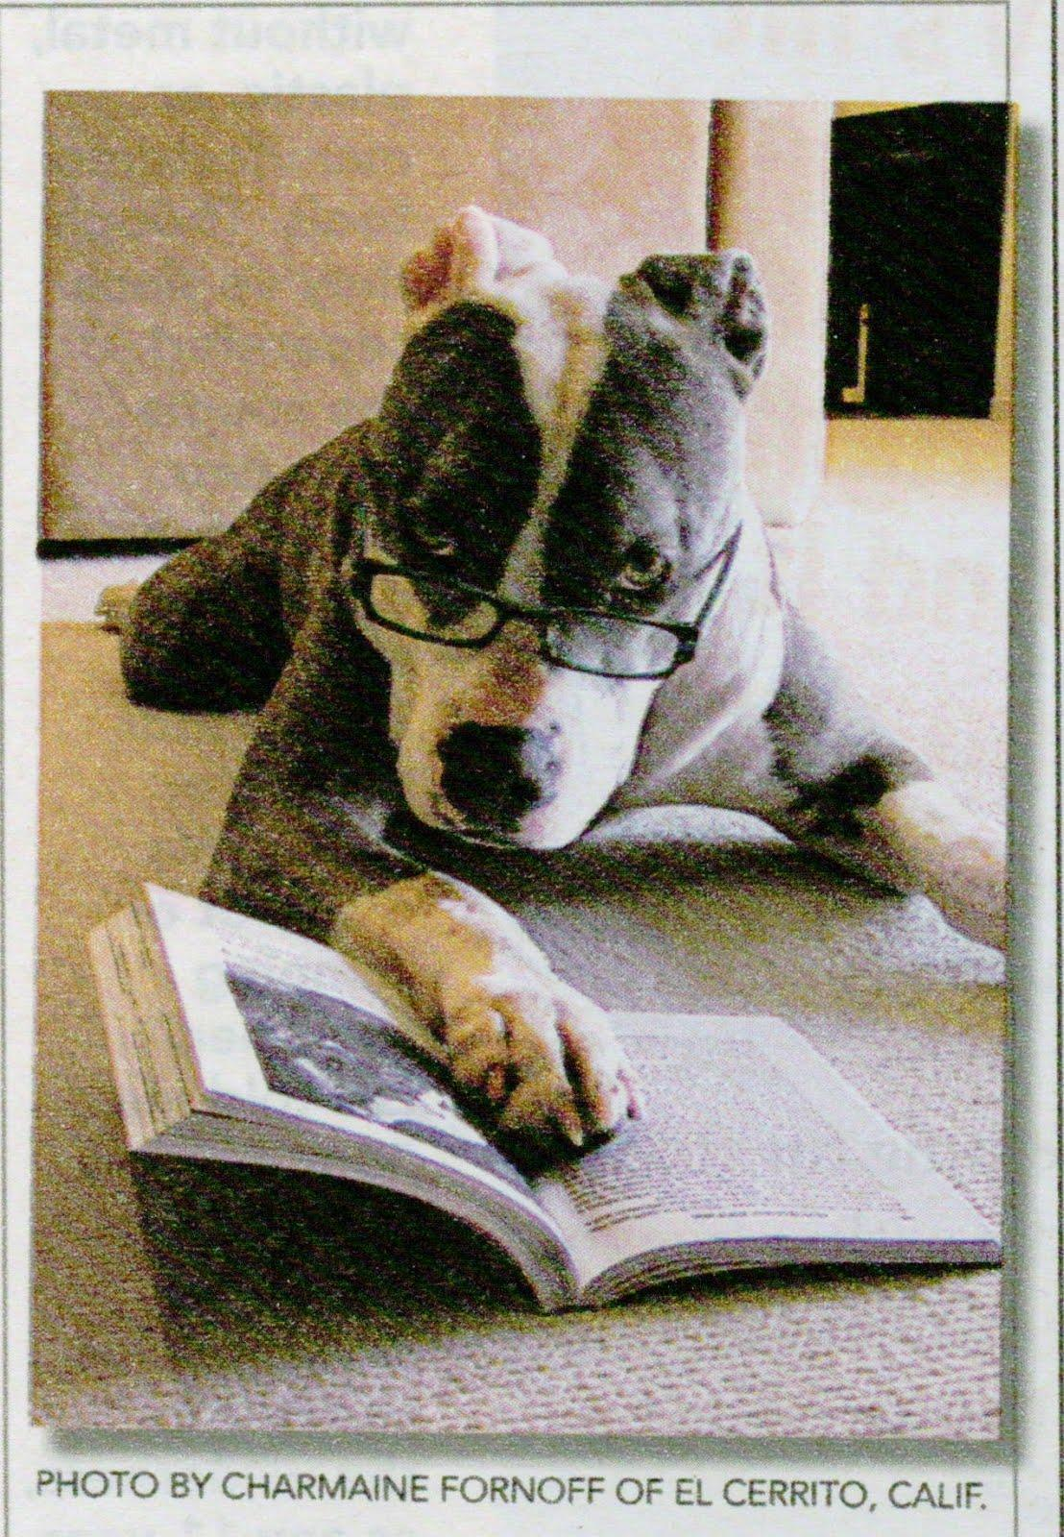
Welcome to your library
Melbourne High School Library
Photo source: Charmaine Fornoff
Notes:
Welcome to your library, teachers.

Slide 2
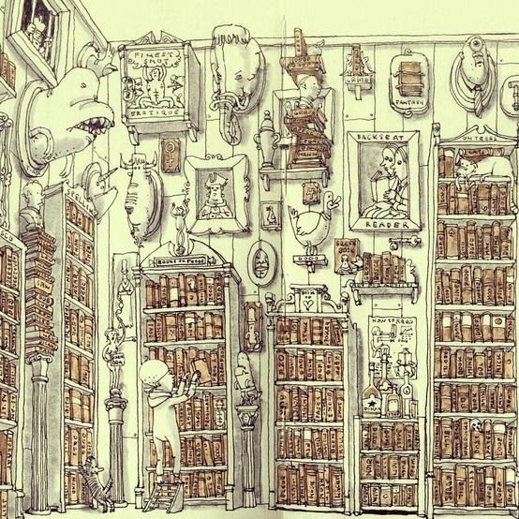
Yes, we are a space
Photo source: Matthias Adolfsson

Slide 3
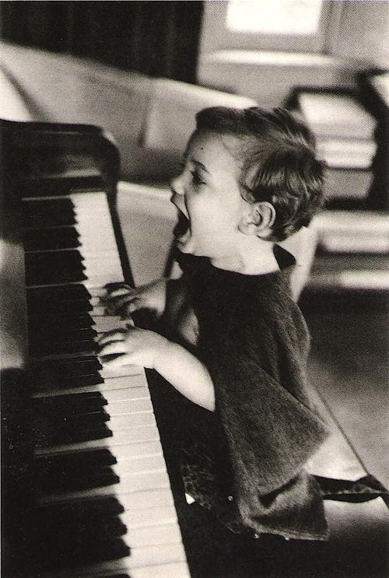
Just above Music
Photo source: http://www.faciepopuli.com/post/29683802019/jacques-lowe-the-joy-of-music-n-y-c-1960

Slide 4
But we also more than a space
"The library of the future is a platform for participation and cooperation with users increasingly sharing information among themselves as well as drawing on the library’s resources." Charles Leadbeater
Notes:
We are not isolated, we are part of the school, the curriculum and the everyday learning and teaching. We're here to work with you.

Slide 5
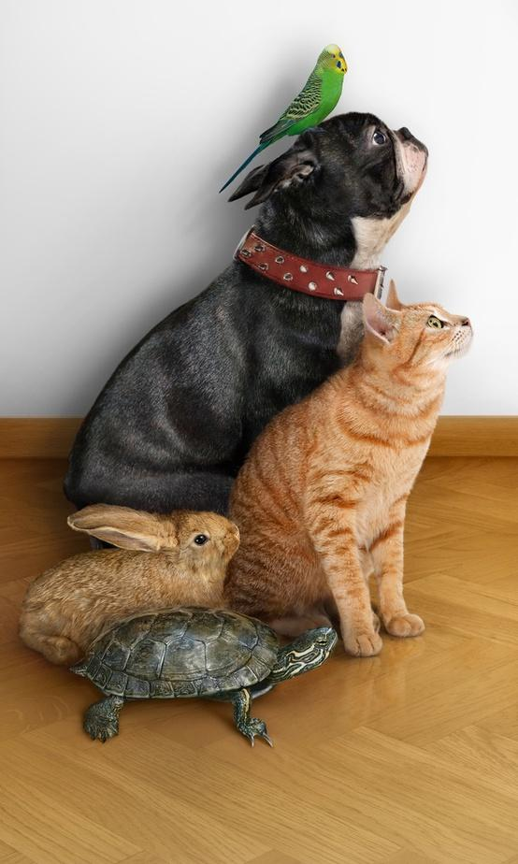
The team
Photo source: http://www.behance.net/gallery/MASCOTA-Feria-de-Barcelona/2316388
Notes:
Okay, so who are we? Humour me as I introduce the team.

Slide 6

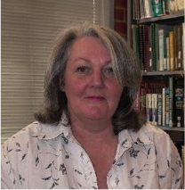

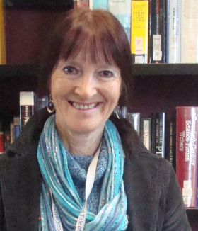
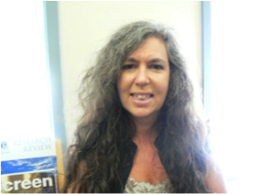
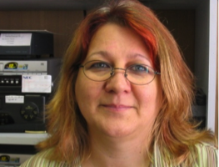
Library staff
Maggie Arundell - teacher librarian
Tania Sheko - Teacher librarian
Marie Buckland - Teacher librarian
Barbara McColl - Teacher librarian
Jenny Krasnowski - Library technician
Denise Beanland - Library technician

Slide 7
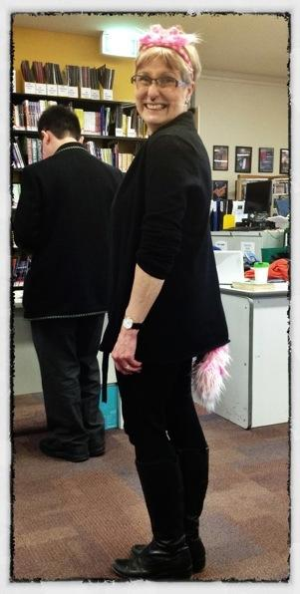
Responsible for library management system and collection development
Working with faculties:
History and Politics
Geography
Chemistry
Biology
Maggie Arundell

Slide 8
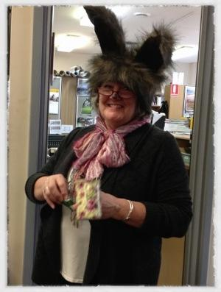
Responsible for -
Reading promotion
Literature support
Working with faculties:
Commerce and Legal Studies
Maths
Accounting
Business Management,
Economics
English
Marie Buckland

Slide 9
Responsible for -
Reading promotion
Working with faculties:
English
Psychology
Drama
Health and Human Development
Barbara McColl

Slide 10
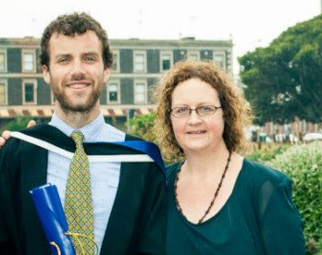
Responsible for -
Management of the library and its staff
Passion: connecting your classes to the outside world (anywhere, anytime learning)
Tania Sheko
@taniatorikova
Working with faculties:
Studio Arts
Visual Communication Design
LOTE
Music
English Language
English

Slide 11
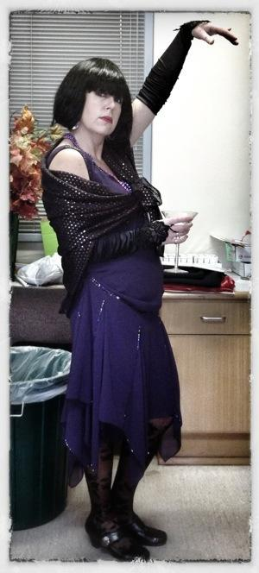
Responsible for -
journals/periodicals
promotional displays
photography
reading promotion (displays)
parent volunteers
Denise Beanland - Library technician

Slide 12
Responsible for -
Cataloguing
Audio-visual
Clickview
Jenny Krasnowski - Library technician

Slide 13
We have always been about...
Notes:
So what are we about? We've always been about ...

Slide 14

Notes:
books, about reading, thinking, understanding, thinking, discussing...

Slide 15
What's new?
Notes:
So what's new?

Slide 16

We've gone quiet
Photo source: http://www.goodreads.com/user/show/4048840-hallowwanderer
Notes:
We've gone quiet during class times

Slide 17
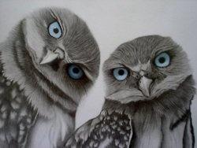
What!?
Photo source: http://aquieterstorm.tumblr.com/archive

Slide 18
You heard correctly

Slide 19
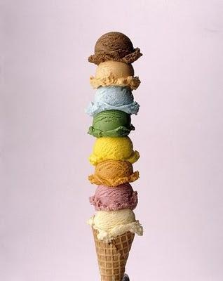
There is a choice for VCE students
in private study
Photo source: http://thewholeenchelleada.blogspot.com.au/2010/09/creative-challenge-day-nine.html

Slide 20
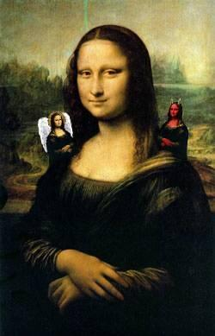
Silent individual study in the library
or
collaborative study/quiet discussion in the dining hall
Photo source: http://www.megamonalisa.com/index.php?page=authors&author=Mr+Rallentando&artwork=dilemma

Slide 21

Photo source: http://9gag.com/gag/228577

Slide 22
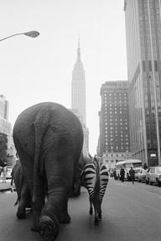
The library is a shared space.
Respect your fellow students.
Photo source: http://imgfave.com/search/elephants
Notes:
Our message to the students is to respect others in a shared space

Slide 23
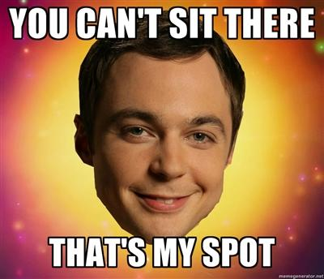
Don't move the furniture please
Notes:
To encourage silent study, we've arranged 2 chairs to a table in the VCE private study area.

Slide 24
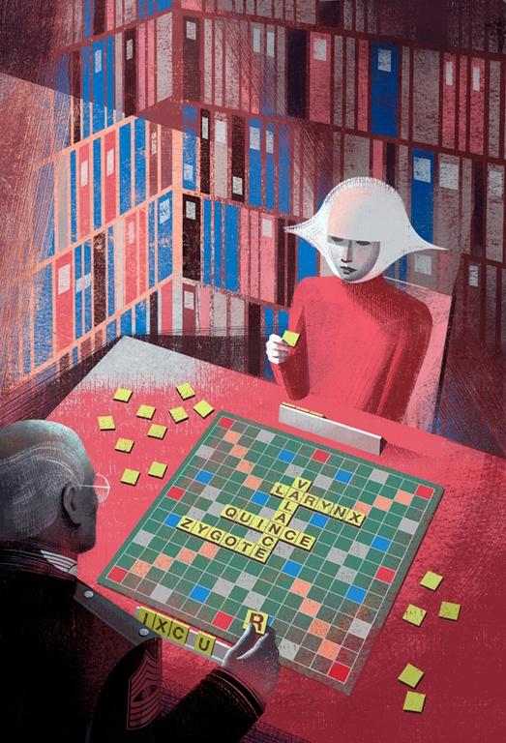
No games during class time
Elena Balbusso
Notes:
We have some basic rules: No games during class time

Slide 25

No bags in library
Notes:
No bags in the library

Slide 26

Definitely no food
http://thechive.files.wordpress.com/2012/11/dumb-people-stupid-37.jpg
Notes:
Definitely no food in the library - this is a struggle

Slide 27
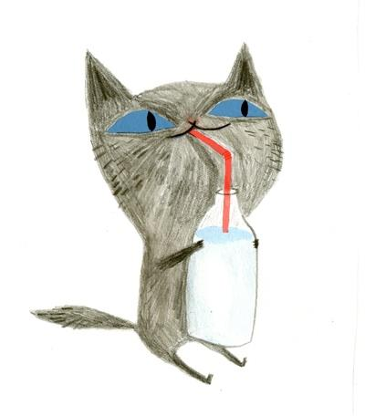
Sorry, no juice bottles allowed, only water bottles
Photo source: http://littlechien.tumblr.com/post/35552263724/littlechien-via-allakinda-ellarbailey-and

Slide 28
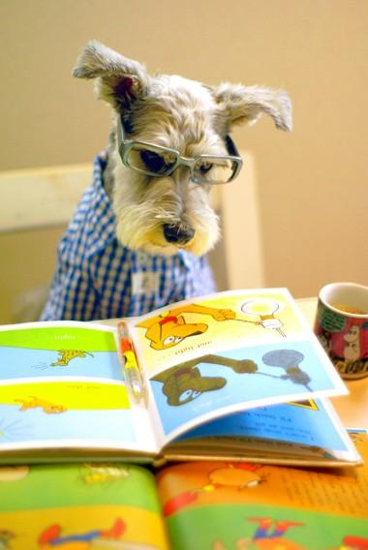
The library is (obviously) a great place to read quietly
Photo source: http://eintail.exblog.jp/14640081/

Slide 29
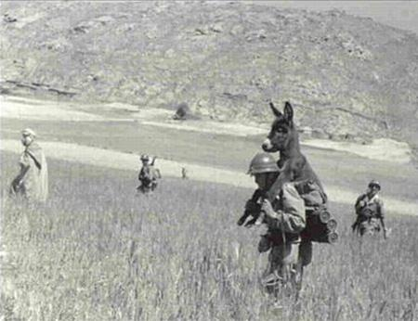
How we support students
Photo source: http://blackandwtf.tumblr.com/post/436688241/via-farrah

Slide 30

Research is a life skill
We are always seeking information. What car or stereo should I buy? Which college should I choose? Which book should I read next?
Image source: http://scribol.com/stories/geek/recent

Slide 31
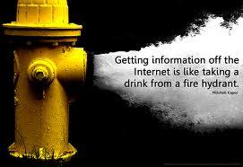
And don't forget,
we help you find and manage information
Photo by Will Lion, via Flickr
Notes:
We help students find and manage information

Slide 32
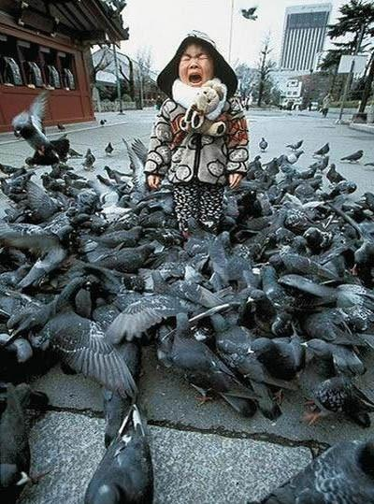
Sometimes there's just too much
Photo source: http://otgilbert.piccsy.com/

Slide 33
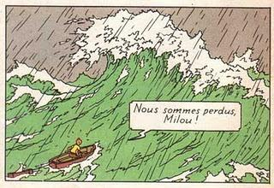
Students can get lost
Notes:
Without guidance, students can get lost in their research process, especially with an overwhelming number of results

Slide 34

Photo source: http://jabberworks.livejournal.com/518224.html

Slide 35

How can we help you?

Slide 36

What can we do for you?
(Nothing is too difficult)
Image source: http://img-thumb.ffffound.com/static-data/assets/6/973acdd98201c3245b67c72991aa2a96050a82c5_s.jpg

Slide 37

Let us know!
Perhaps -
Resource or assignment development
Collaborative teaching
Specialist teaching (information fluencies; responsible & ethical online behaviour)
Collaborative workspaces; engagement through social media (eg blogs)

Slide 38

We see the task beyond the technology
Notes:
We can help you use technology for learning, not learn to use technology

Slide 39
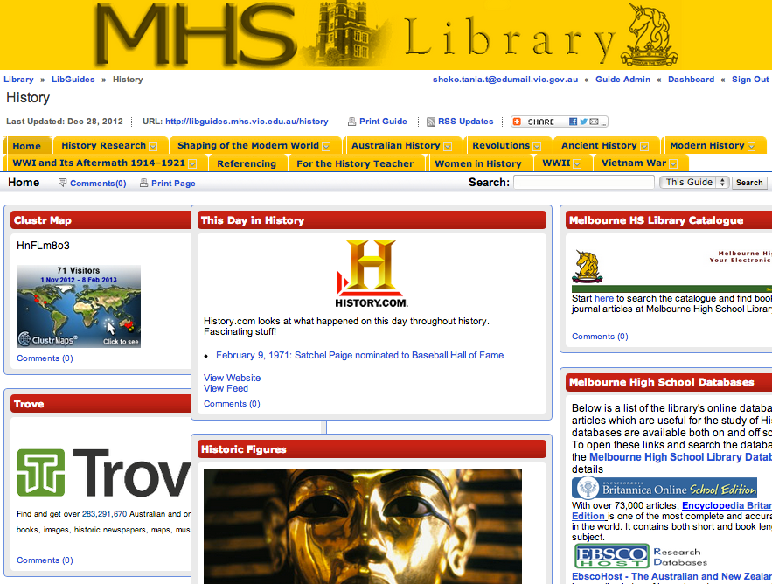
Check out our online curriculum resources
Notes:
Our library webpages. Make a time with us and we'll show you around this resource. Let us know what to add, what you need, how you'd like it organised.

Slide 40

How you can help us
please send maximum of 6 students to the library with a note
talk to us
give us time to prepare quality resources
collaborate with us

Slide 41
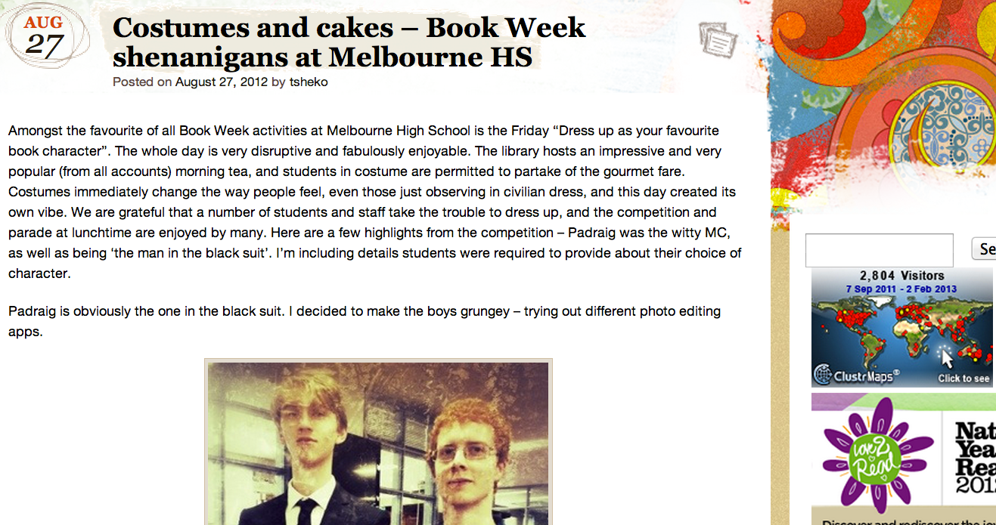
Read our blog!
http://melbhslibrary.wordpress.com/

Slide 42

Don't forget to unplug
Photo source: http://wordpainting.tumblr.com/post/19393858053

